Slide 1
Brief Introduction to Natural Language Processing
Anoop Sarkar

Slide 2
Why is NLP computationally hard?

Slide 3
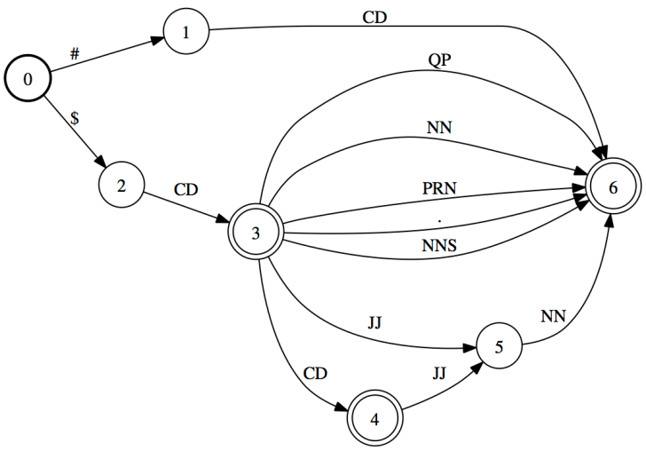
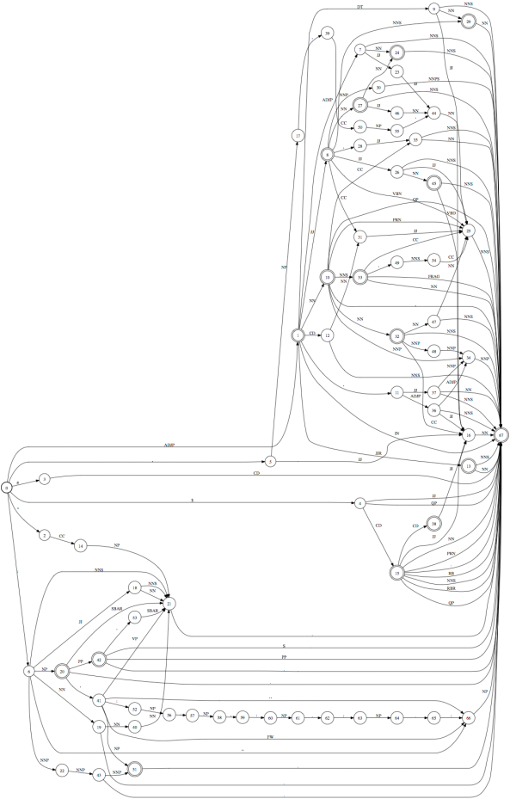
JJ
NN
NN
noun phrase type
bronchial
brush
specimen
perthoracic
needle
aspiration
10 noun phrase types
100 noun phrase types
6K noun phrase types
Language is complex
1000 noun phrase types

Slide 4
Language is ambiguous
Lung cancer in women mushrooms
Mushrooms is noun or a verb?
Ban on nude dancing on governor's desk
Similar to common ambiguity in programming languages
Island Monks Fly in Satellite to Watch Pope Funeral
“fly in” vs. “fly [_{OBJ} in Satellite]” hidden segmentation
British Left Waffles on Falkland Islands
Is it British/Noun Left/Verb or British Left/NP Waffles/Verb?

Slide 5
Language is Parsed
for more see crashblossoms.com
Google's Computer Might Betters Translation Tool
New York Times March 8, 2010
Number of Lothian patients made ill by drinking rockets
Edinburgh Evening News, March 4, 2010
Violinist linked to JAL crash blossoms
http://languagelog.ldc.upenn.edu/nll/?p=1693

Slide 6
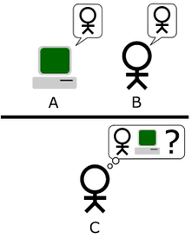

Imagine an "Imitation Game," in which a man and a woman go into separate rooms and guests try to tell them apart by writing a series of questions and reading the typewritten answers sent back. In this game both the man and the woman aim to convince the guests that they are the other.
We now ask the question, "What will happen when a machine takes the part of A in this game?" Will the interrogator decide wrongly as often when the game is played like this as he does when the game is played between a man and a woman? These questions replace our original, "Can machines think?"
Alan Turing

Slide 7
Winograd Schema
(H. Levesque, AAAI 2011)
The town councillors refused to give the angry demonstrators a permit because they feared violence.
Who feared violence?
Answer 0: the town councillors
Answer 1: the angry demonstrators
The town councillors refused to give the angry demonstrators a permit because they advocated violence.
Who advocated violence?
Answer 0: the town councillors
Answer 1: the angry demonstrators

Slide 8
What is the difference?
NLP = Natural Language Processing
Building useful systems
CL = Computational Linguistics
Understanding human language

Slide 9
Different levels of language

Slide 10

Different levels of language
Phonetics: acoustic and perceptual elements
Phonology: basic sounds (phonemes) and rules for combination
e.g. vowel harmony. Anupu is pronunciation of Anoop in Classic Period Mayan
Morphology: how morphemes combine to form words, relationship of phonemes to meaning
e.g. delight-ed vs. de-light-ed

Slide 11
Different levels of language
Syntax: sentence formation
e.g. The clown who the musician hits watches the ballerina
Semantics: meaning (from syntax to logical formulas)
e.g. Everyone is not here => what does this mean? Nobody / Not everyone is here.
Pragmatics: meaning that is not part of compositional meaning,
e.g. Tim dresses even worse than Anoop!

Slide 12
Some examples of NLP tasks
(bio-medical and clinical)

Slide 13
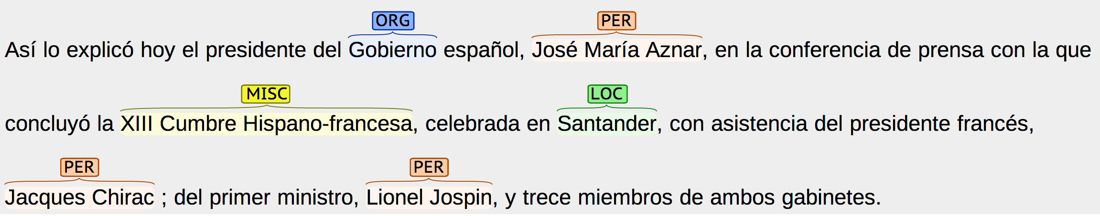
Information Extraction

Slide 14
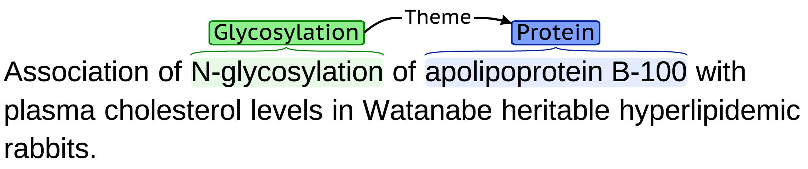
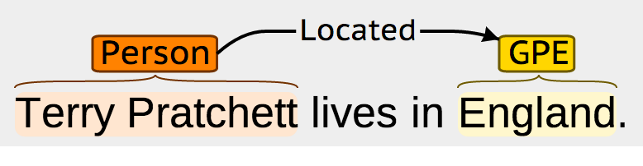
Information Extraction

Slide 15
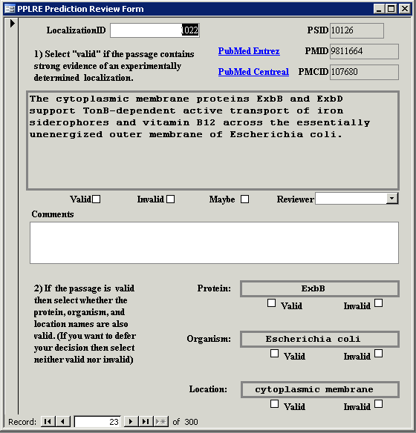

Slide 16
PICO frames (Cochrane)

Slide 17
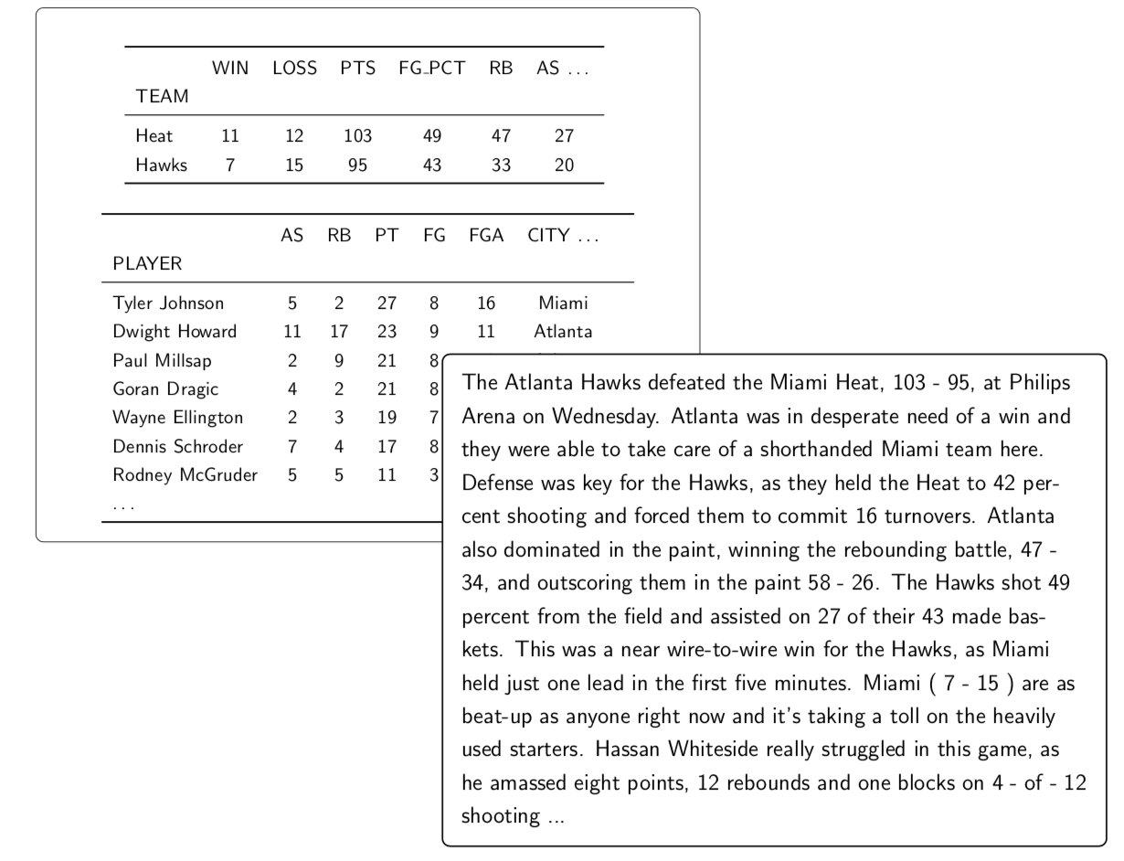
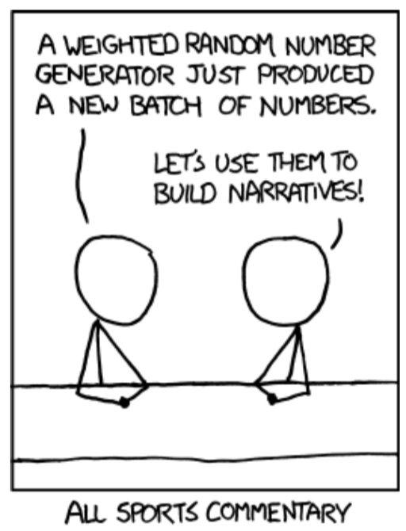
Natural Language Generation

Slide 18
Natural Language Generation
Primary finding: 23x18 mm nodule in right upper node
Features: Mixed solid and ground glass attenuation. >2cm from carina. No atelectasis. Contains visceral pleura. Satellite micronodule in same lung.
Additional Findings: 15mm right paratracheal node; 10mm subcarinal node. Small right pleural effusion. No visible metastases. Subpleural interstitial fibrosis.
Conclusion: Probable primary lung cancer. Clinical stage: Stage IV. Other differential: Fungal infection.

Slide 19
Natural Language Inference (NLI)
Samples from the MedNLI Corpus

Slide 20
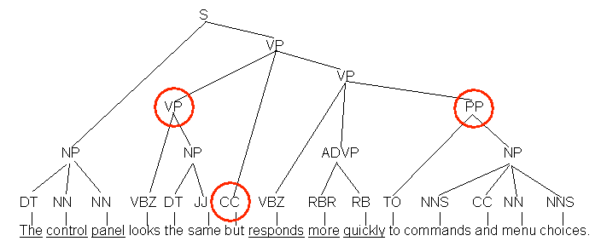
Sentence Compression

Slide 21
Paraphrasing
open borders imply increasing racial fragmentation in european countries .
open borders imply increasing racial fragmentation in the countries of europe .
open borders imply increasing racial fragmentation in european states .
open borders imply increasing racial fragmentation in europe .
open borders imply increasing racial fragmentation in european nations .
open borders imply increasing racial fragmentation in the european countries .

Slide 22
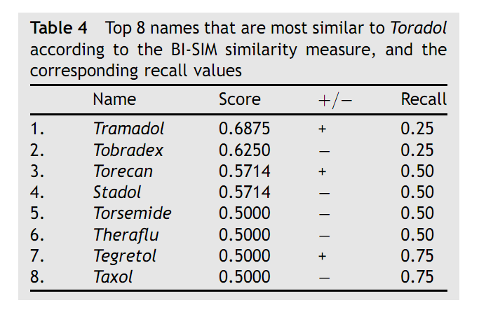
Identifying confusable drug names
G. Kondrak and B. Dorr

Slide 23
Deep Learning (neural networks) for NLP

Slide 24
It is a black box
class
Represent sparse discrete data like words as dense vectors
Creates natural groups due to the classification
token
Tokens can be words, characters, documents, …

Slide 25
Inside are more black boxes
class
What makes a neural network?
(1) Multiple layers / “deep” networks model combinations of features
What makes a neural network?
(2) Each transfer is a non-linear function
token

Slide 26
Generalize to sequences
class
class
class
class
class
Hidden layer
Word embedding
token
token
token
token
token

Slide 27
Demos

